Slide 1






Rossmann Store Sales
Our Fun Journey Through a Data Science Project
Instructor:
Eng. Ahmed Mostafa

Slide 2






Welcome to Digital Egypt!
In this presentation, we will explore
how landscape of
can transform the
. Get ready to
uncover the of numbers and statistics that can drive innovation and growth in our vibrant nation!

Slide 3









What is Data Science?
Data science is all about turning into . It combines
,
, and
to solve problems and make
. Let's explore how we applied these principles in our project!

Slide 4


Our Project Goals
We had clear objectives to analyze historical sales trends, identify key factors influencing store performance, and develop an accurate model to predict future sales. By focusing on these goals, we aimed to provide actionable insights for store management and improve forecasting to drive business growth.

Slide 5
Data Exploration
AH.Reda
Data Wrangling
A.Tony
Data Visualization
A.Ramad
Deployment
Mo.Hagag
Data Collection
Mo Hagag
EDA
A.Tony & A.Ramad

Slide 6
Modelling
A.Tony
Feature Engineering
A.Ramadan
Pipeline Imputing
Ahmed Reda
Model Selection &Hyperparameter & Evaluation
Mo.Hagag
Dashboards & Deployment
UI Streamlit
Api Fastapi
Power Pi Dashboard

Slide 7

Data Collection Process
Our first step was collecting data from trusted sources.We obtained the Rossmann Store Sales dataset from Kaggle, which includes detailed sales information, promotions, holidays, and store characteristics.
This comprehensive dataset laid the groundwork for our analysis and
predictive modeling.

Slide 8


Exploratory Data
Analysis
We thoroughly examined the dataset to identify any missing values, inconsistencies, or errors. This step ensured the data was prepared for cleaning. Following that, we explored key patterns and trends through data visualization, gaining deeper insights into the factors affecting sales.

Slide 9


Data Cleaning Fun
We addressed missing values and inconsistencies. For instance, we filled missing CompetitionDistance using median values, interpolated CompetitionOpenSinceMonth and CompetitionOpenSinceYear, and replaced nulls in Promo2SinceWeek and Promo2SinceYear with 0.
Additionally, missing PromoInterval
entries were labeled as "Missing." This prepared the dataset for
modeling.

Slide 10
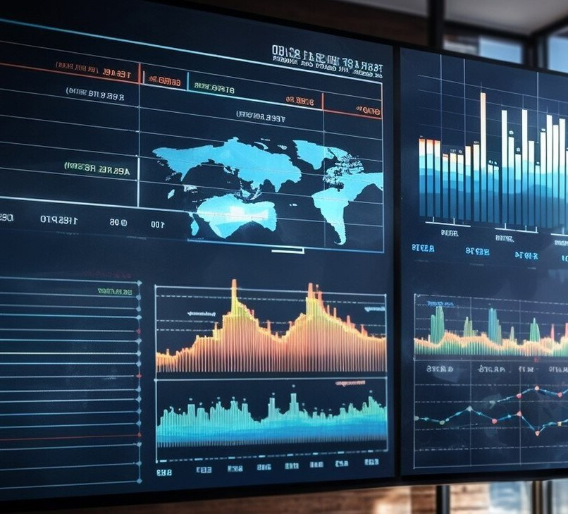

Data Visualization
We used Power BI to create visualizations that highlighted important patterns and trends in the data. This involved identifying sales seasonality, the impact of promotions, and store-specific influences. These insights were crucial for guiding our analysis and improving our understanding of the
data.

Slide 11


Modeling and Algorithms
We applied feature engineering techniques and built a pipeline to prepare the data for machine learning algorithms. We experimented with different models to predict store sales and optimize performance. Choosing the right model, along with proper feature selection, was key to achieving accurate results. It was like crafting a data-driven strategy to unlock valuable insights!

Slide 12
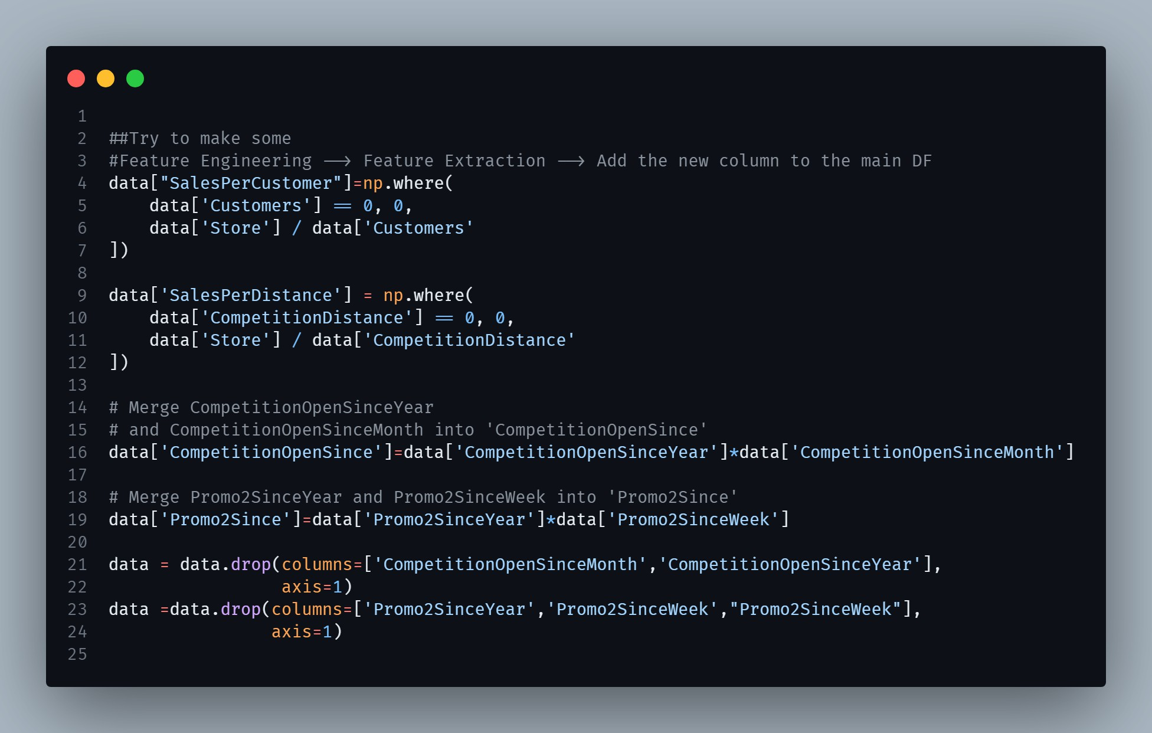
Feature Engineering
We created new features to enhance model performance. For example, we added SalesPerCustomer and SalesPerDistance to capture the relationship between sales, customers, and competition. We also merged CompetitionOpenSinceYear with CompetitionOpenSinceMonth and Promo2SinceYear with Promo2SinceWeek to simplify the data. These new features helped improve the accuracy of our predictions.

Slide 13
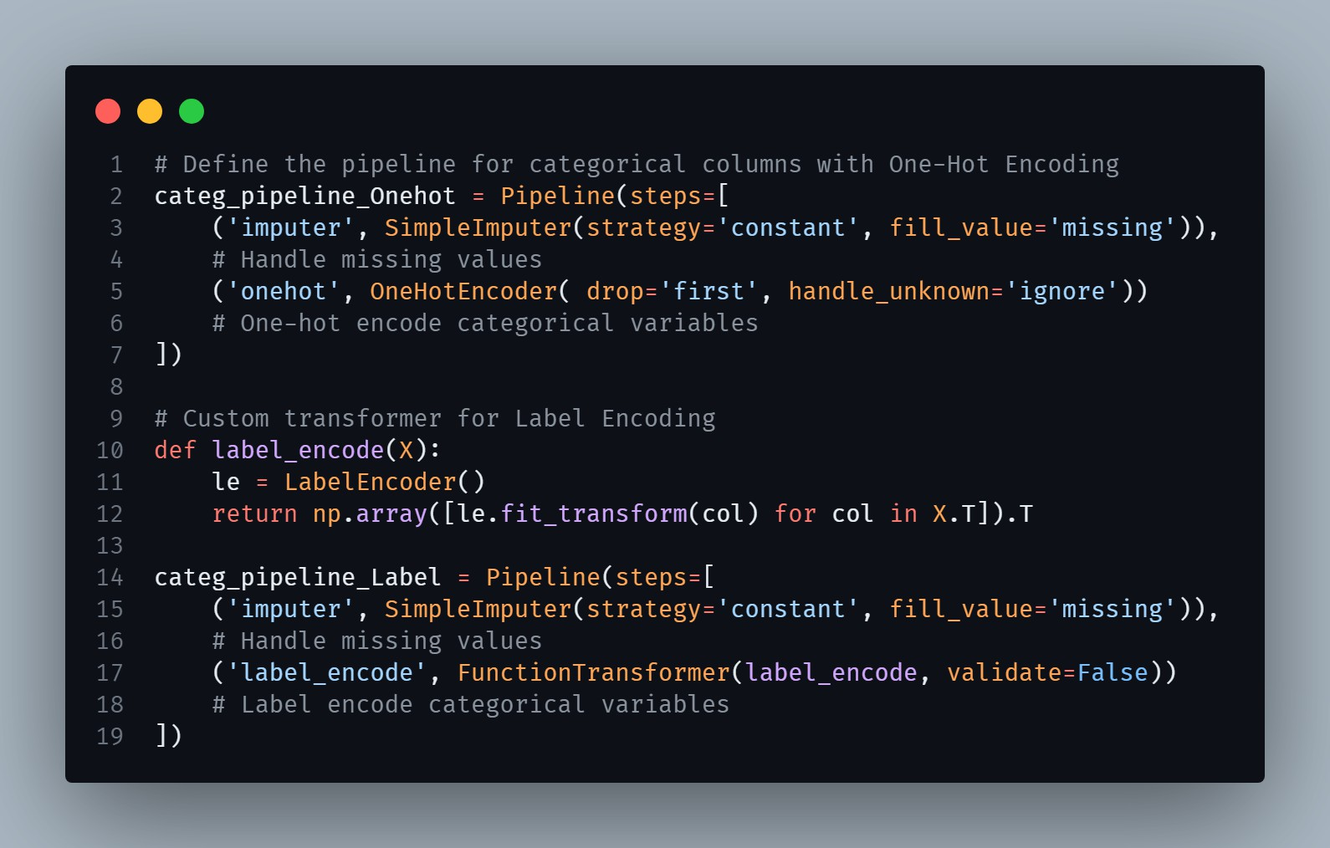
Pipeline-Imputing
We built a preprocessing pipeline to handle both numerical and categorical features.
Missing numerical values were imputed
using median or most frequent strategies,
while categorical features were processed using One-Hot Encoding or Label Encoding. After transforming the data, we applied standard scaling to the numerical features for consistent model input. The full pipeline was then used to prepare the data for prediction, feeding it into a pre-trained XGBoost model to forecast sales accurately.

Slide 14
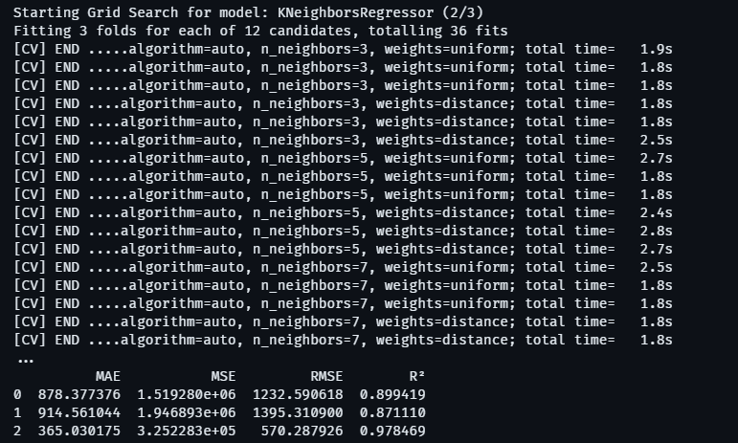

Model Selection
The script optimized three regression models
—SGDRegressor,KNeighborsRegressor, andXGBRegressor—usingGridSearchCVfor hyperparameter tuning. Each model was evaluated with 3-fold cross-validation,
focusing on negative mean squared error. The best hyperparameters were identified,
models were saved, and key metrics (MAE, MSE, RMSE, R²) were calculated and summarized in a DataFrame.
Ultimately,XGBRegressorwas chosen as the best-performing model with accuracy 97.8%.
and testing in in testing Data with 97.6%.

Slide 15

Model Deployment
The model was deployed using three different methods: Streamlit, Power BI, and FastAPI. The deployed model utilized the XGBRegressor, which was saved as a PKL file, allowing for efficient loading and inference in each application. This multi-faceted deployment approach facilitates easy access and integration of the model across various platforms.

Slide 16
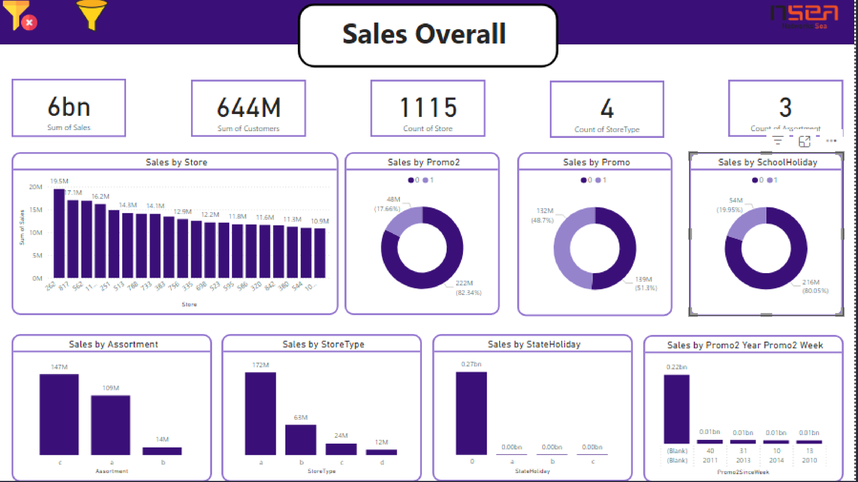

Slide 17







Challenges We Faced
Every project has its ! We encountered issues like ,
, and unexpected
. However, these obstacles
taught us valuable lessons and made our journey even more .

Slide 18




Team Collaboration
Collaboration was key to our success! Our team brought together diverse and
. We learned to communicate
effectively and support each other, making
our project not just productive but also a lot of !

Slide 19






What We Learned
This project taught us about the
importance of
, effective
, and the power of
. We also learned to
embrace and adapt our strategies as we uncovered new insights along the way.

Slide 20





Conclusion: The Journey Continues
Our data science project was a filled with and
journey
. As we move
forward, we’re excited to apply these insights and continue exploring the world of .
Remember, every dataset tells a story!

Slide 21


Thanks!
Do you have any questions?
omer84484@email.com
+20 102 671 9792

